Slide 1
A Report on
My STEM Fair Investigation
Your name goes here
Notes:
You can change the Layout of your Slides if you would like. You can change the font and color. The black slides are for you to type on. The gray slides show you an example and should be deleted before you present. You can also add more slides if needed. Currently there is only one slide for pictures, but you can add more if you want/need to.

Slide 2
A Report on
My STEM Fair Investigation
Dani Hodgson
Notes:
All the gray slides are EXAMPLE SLIDES. DELETE them before presenting.

Slide 3
Type the title of your project
Notes:
Create a creative title for your project. It is what will be on the top of your science fair board if you enter the fair.

Slide 4
“What is Blocking my WiFi Signal?”
Notes:
EXAMPLE PAGE

Slide 5
My Investigation Purpose or Question
The purpose of my project was
Notes:
Explain what you tested or built.

Slide 6
My Investigation Purpose or Question
The purpose of my project was to determine how different substances might affect the wi-fi signal in my home.
Notes:
THIS IS the EXAMPLE SLIDE. DELETE it before presenting.

Slide 7
Why did I chose this investigation?
I chose to do this investigation because
Notes:
What made you choose this particular project.

Slide 8
Why did I chose this investigation?
I chose to do this investigation because there is a phenomena in my house where different areas in my house get better wifi coverage than others. I wanted to see if I could figure what what might be affecting it my wifi signal.
Notes:
THIS IS the EXAMPLE SLIDE. DELETE it before presenting.

Slide 9
My Hypothesis or Prediction
I think that if I then because
Notes:
Be sure to include what you did and what you thought would happen. It is important to also explain WHY you thought that.

Slide 10
My Hypothesis or Prediction
I think that if I cover my router with different types of materials, then the cotton blanket will block the signal the most because it is the thickest. I know that it is harder to hear sound through thick things, so I think it will be harder for Wifi waves to go through thick things.
Notes:
THIS IS the EXAMPLE SLIDE. DELETE it before presenting.

Slide 11
Variables
Independent Variable:
Dependent Variable:
Constants:
Control:
Notes:
Remember the phrase “How does _______ effect ________?” The first blank is the independent variable or the thing you are testing. The 2nd blank is the dependent variable. It describes what is affected. Constants are all of the things that you have to keep the same to make a fair test. A control is used in some but not all projects. A control is the thing that you don’t test so you can have something to compare your results to. If you are unsure whether you should include a control, ask your teacher.

Slide 12
Variables
Independent Variable: Different Substances
Dependent Variable: The strength of the wifi signal
Constants: The app used and the amount of time each substance was tested.
Control: Unblocked wifi signal
Notes:
THIS IS the EXAMPLE SLIDE. DELETE it before presenting.

Slide 13
How I designed and carried out my investigation.
Notes:
Example:
This is like a recipe. This is where you tell WHAT you do in the order that you did it.

Slide 14
How I designed and carried out my investigation.
I collect 5 different objects made from different materials in my home.
I downloaded an app that gives wifi strength readings.
I tested the objects by placing one at a time around the router as much as possible.
I tested each object at 30 cm away, 3 meters away, 10 meters away and 50 meters away for 30 sec each. I used the highest percentage from that 30 seconds.
I repeated the test 3 times for each substance.
I calculated the average for each substance and then the average for all distances.
Notes:
THIS IS the EXAMPLE SLIDE. DELETE it before presenting.

Slide 15
Attach one of the picture of your project or you doing your project on this page
Notes:
Attach pic by clicking on the box with a mountain in it.

Slide 16
Analyzing and Interpreting Data
The data collected
Notes:
Example:
The data collected was the strength of the wifi signal. I calculated the average of the signal at each distance. The following page show my graph.

Slide 17
Analyzing and Interpreting Data
The data collected was the strength of the wifi signal. I calculated the average of the signal at each distance. The following page shows my graph.
Notes:
Delete before presenting

Slide 18
Analyzing and Interpreting Data
You can put a graph, table or picture here.
Notes:
You can insert a table and make a graph by clicking on Insert--Chart--then choose which one you want.

Slide 19
Analyzing and Interpreting Data
You can put a graph, table or picture here or delete this slide if you do not need it.
Notes:
You can insert a table and make a graph by clicking on Insert--Chart--then choose which one you want.

Slide 20
Table of Substance Measurements
Substance | 30cm | 3 m | 10 m | 50 m | Average
Nothing | 95 | 94 | 90 | 89 | 92
Styrofoam | 95 | 94 | 89 | 88 | 91.5
Cast Iron | 80 | 75 | 60 | 50 | 66.25
Aluminum | 90 | 89 | 85 | 81 | 86.25
Cotton | 94 | 91 | 89 | 88 | 90.5
Glass | 94 | 90 | 85 | 83 | 88
Notes:
Delete before presenting

Slide 21
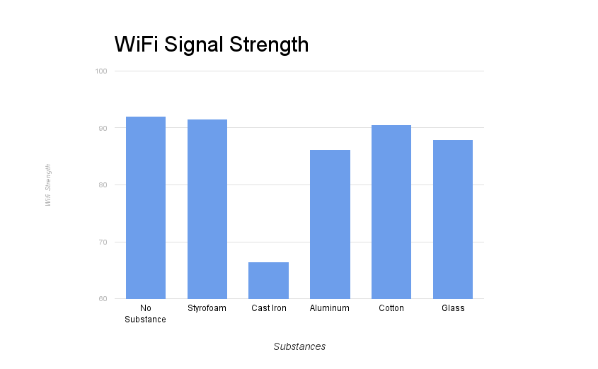
Notes:
Delete before presenting

Slide 22
Analysis of the data
The data showed me
Notes:
Explain what the data means.

Slide 23
Analysis of Data
I originally thought that the blanket would lower the signal but according to the data collected, the substance the blocked the signal the most was the cast iron with a signal of only 66.25. The substance that blocked it the least was styrofoam with a signal of 92.
Notes:
EXAMPLW

Slide 24
Constructing Explanations or Designing Solutions
Type here
Notes:
This page is for you to EXPLAIN WHY you got the results that you did. What is the Science behind what happened? You WILL need to do some research to help you explain WHY. Be sure to site your source. Sources may include: Internet sites, professional people or experts, books, science magazines etc.

Slide 25
Constructing Explanations or Designing Solutions
In doing some research to find out why I got the results that I did, I found out that a WiFi signal is made of radio waves that can transmit information from one device to another. Radio waves are electromagnetic waves. Metal is a conductor and because metal adsorbs some of the radio waves, it lowers the signal strength. Styrofoam is an insulator, so it allows the signal to freely move through it.
Source: https://www.techwalla.com/articles/how-does-metal-affect-a-wireless-signal

Slide 26
Model
Notes:
The model can be pictures or diagrams that help to explain WHY you got the results that you got. You must have a model. If you don’t know what to use, talk to your teacher.

Slide 27
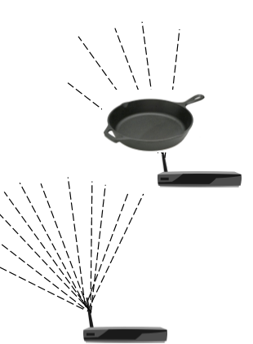
Model
This model show how metal can adsorb some of the radio waves, making the signal weaker.
Notes:
EXAMPLE PAGE

Slide 28
How is what I learned useful?
Notes:
This is the life application page. How does what you learned affect you or those around you. How is this information useful?

Slide 29
How is what I learned useful?
I know that in order to have a good wifi signal, I should make sure that my router is not placed behind metal, like my computer or monitor. The more out in the open it is, the better the signal will be.

Slide 30
Doing it differently
Notes:
If you could redo this experiment again, what would you do differently. Is there a variable that needs to be controlled better? Were you curious about doing anything different?

Slide 31
Doing it Differently
If I were to repeat this project I think I should make sure I used the exact same thickness for each material. Thickness could be a variable that might have affected my results.
I also could have calculated the density of each material to determine if the wifi signal is affected by density or affected by the substance.
Notes:
EXAMPLE PAGE

Slide 32
I Wonder...
Notes:
Here you need to have at least ONE NEW QUESTION question(s) you might have regarding your experiment.

Slide 33
I wonder...
I wonder if there is something I could put on my router that would make the signal better. If cast iron makes it worse, is there a substance that would make it better?

